Slide 1
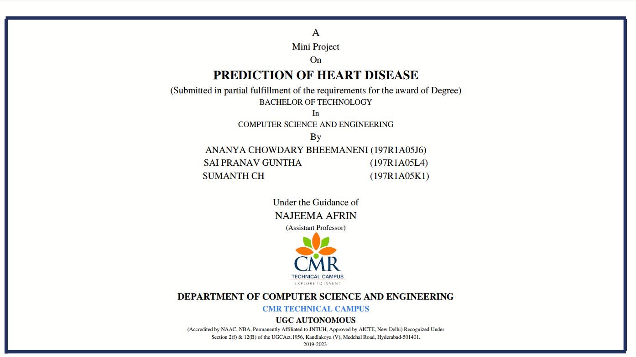
Major Project
CHATBOT FOR PREGNANT WOMEN

Slide 2

CHATBOT FOR PREGNANT WOMEN
Presented by -
Ananya chowdary (197r1a05j6)
Sai pranav guntha (197r1a05l4)
Sumanth ch (197r1a05k1)
Project guide -
Najeema afrin

Slide 3
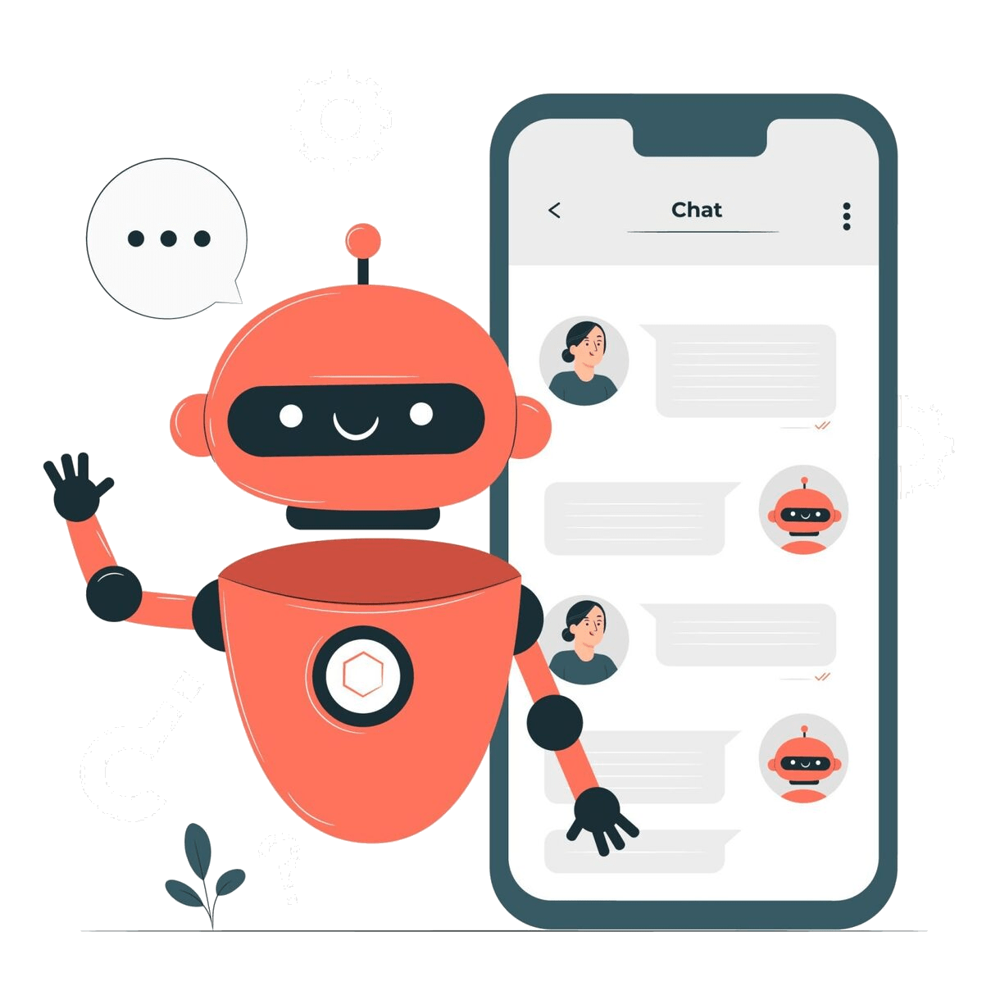
contents
Abstract
Introduction
Existing System
Proposed System
Hardware Requirements
Software Requirements
Novelty of the project
Architecture
Module
UML Diagrams
Conclusion

Slide 4
ABSTRACT
Medical services are basic needs for human life although they normally have limited resources.
Modern technologies are utilized for increasing service capability and decreasing the operation cost.
Auto-response system or chatbot, which is widely known in the field of online businesses, can be applied to the medical services.
Therefore, the objective of this work is to implement the medical consultant system service by using chatbot Technology.
In this project we focus on exploiting AI-based chatbot systems, mainly based on machine learning algorithms and Natural Language Processing, to understand and respond to needs of patients and their families.
In particular, we describe an application scenario for an AI-chatbot delivering support to pregnant women, mothers, and families with young children, by giving them help and instructions in relevant situations.

Slide 5
Existing system
The feeling of interacting with a dehumanized entity when patients are asked to fill forms or answer to a given set of questions by using a predefined given set of answers.
This makes patients more frustrated since they cannot be not able to fully express their symptoms, worries and pains.
Chatbots let patients to feel more comfortable, overcoming the biasing of a machine interaction.
DISADVANTAGES:
The replies given existing forms and applications are dehumanized and robotic.
The data trained in existing system can be faulty or not verified.
These old mode of query solving solutions take time to find the answers to the queries of the users.
The accuracy of the replies is low.

Slide 6
PROPOSED SYSTEM:
In this project we are designing CHATBOT application which helps pregnant women’s to get answers for their queries or doubt.
To build this project we used NLP (natural language processing toolkit) and Machine Learning Algorithm called LSTM (Long Short Term Memory).
LSTM will be trained with all possible questions and answers and whenever user ask any question then LSTM will predict answer for that question and handover that answer to chatbot to display to user.
To train LSTM we have used some questions and answers related to pregnancy as no public dataset available so we gather some questions and answers from internet and all this questions are saved in dataset.
Assistance on time from any place.
Chatbot helps to get answers quickly in a humanoid way.
All the data set trained to the bot will be cross checked to avoid spreading wrong/fake answers.
Chatbot will be active every minute of the clock to help in query solving.
The feedback given by the bot will be similar to that off a doctor, as we are going to only use data set that is verified by doctors.
ADVANTAGES:

Slide 7

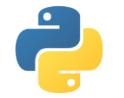

REQUIREMENTS:
HARDWARE REQUIREMENTS:
RAM: 4 gb and above (8 or 16 recommended).
Hard Disk: 250gb and above.
Processor: intel i3 and above
SOFTWARE REQUIREMENTS:
Windows 7 and above
Python 3.7 and above (or)
Anaconda 3.7
Jupiter or Google colab

Slide 8
NOVELTY:
The novelty of this project (CHATBOT FOR PREGNANT WOMEN) is that we are using various advanced techniques and algorithms to build a chatbot system that answers the queries of its users in a humanoid way. Here we are using NLP toolkit and LSTM algorithm to build the chatbot that gives answers to the questions. One of our main objective of this project was to make sure the chatbot replies its users in a humanoid manner. As healthcare industry is evolving every single year, there was an absolute necessary to build a chatbot system that gives accurate data that is similar to doctors prescriptions and is available every single minute in the clock to help people in solving their queries.

Slide 9
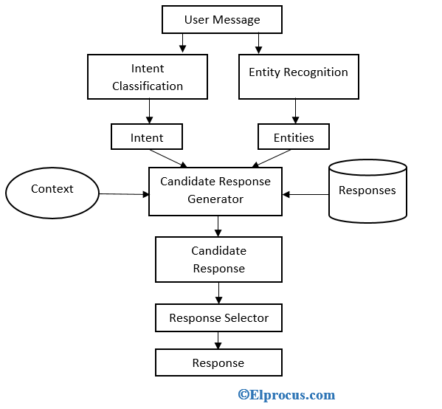
architecture:

Slide 10
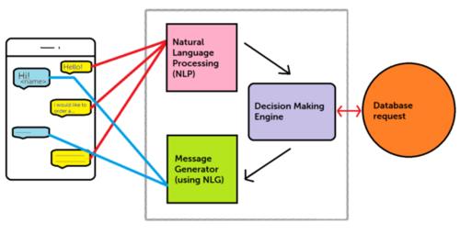
architecture:

Slide 11
module:
Here are the major modules in the Chatbot:
Take the input from the user.
Analyze the users request given to the chatbot.
Identify the Intent and Entities.
Look for the accurate solutions from the database.
Compose the solution in human manner.
Passout the answer to the user.

Slide 12
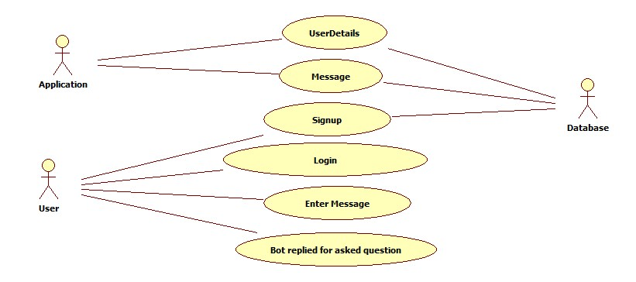
uml diagrams:
Use Case Diagram:

Slide 13
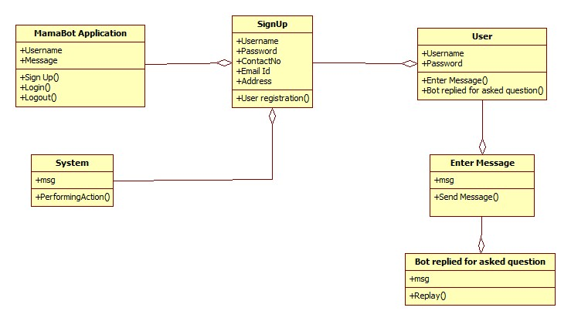
uml diagrams:
Class Diagram:
ChatBot Application.
Signin page
User data

Slide 14
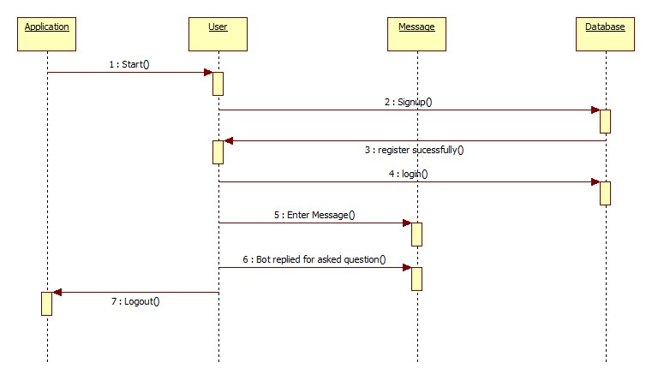
uml diagrams:
Sequence Diagram:

Slide 15
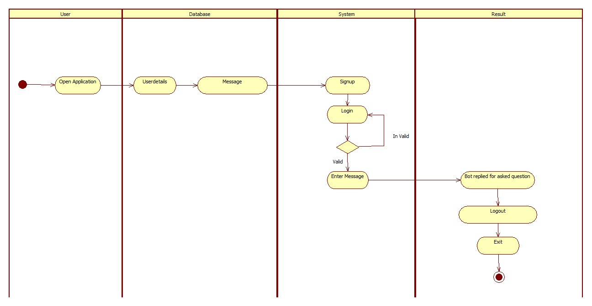
uml diagrams:
Activity Diagram:

Slide 16
sample code
import json
import numpy as np
import nltk
# nltk.download('punkt')
from nltk.stem.porter import PorterStemmer
import torch
import torch.nn as nn
from torch.utils.data import Dataset,DataLoader
my=open('/content/FinaldataV1.json','r')
jsondata=my.read()
intents=json.loads(jsondata)
stemmer = PorterStemmer()
def tokenize(sentence):
"""
split sentence into array of words/tokens
a token can be a word or punctuation character, or number
"""
return nltk.word_tokenize(sentence)
import json
import torch
import torch.nn as nn
class NeuralNet(nn.Module):
def __init__(self, input_size, hidden_size, num_classes):
super(NeuralNet, self).__init__()
self.l1 = nn.Linear(input_size, hidden_size)
self.l2 = nn.Linear(hidden_size, hidden_size)
self.l3 = nn.Linear(hidden_size, num_classes)
self.relu = nn.ReLU()
def forward(self, x):
out = self.l1(x)
out = self.relu(out)
out = self.l2(out)
out = self.relu(out)
out = self.l3(out)
# no activation and no softmax at the end
return out

Slide 17
sample code
# stem each word
sentence_words = [stem(word) for word in tokenized_sentence]
# initialize bag with 0 for each word
bag = np.zeros(len(words), dtype=np.float32)
for idx, w in enumerate(words):
if w in sentence_words:
bag[idx] = 1
return bag
def stem(word):
"""
stemming = find the root form of the word
examples:
words = ["organize", "organizes", "organizing"]
words = [stem(w) for w in words]
-> ["organ", "organ", "organ"]
"""
return stemmer.stem(word.lower())
def bag_of_words(tokenized_sentence, words):
"""
return bag of words array:
1 for each known word that exists in the sentence, 0 otherwise
example:
sentence = ["hello", "how", "are", "you"]
words = ["hi", "hello", "I", "you", "bye", "thank", "cool"]
bog = [ 0 , 1 , 0 , 1 , 0 , 0 , 0]
"""

Slide 18
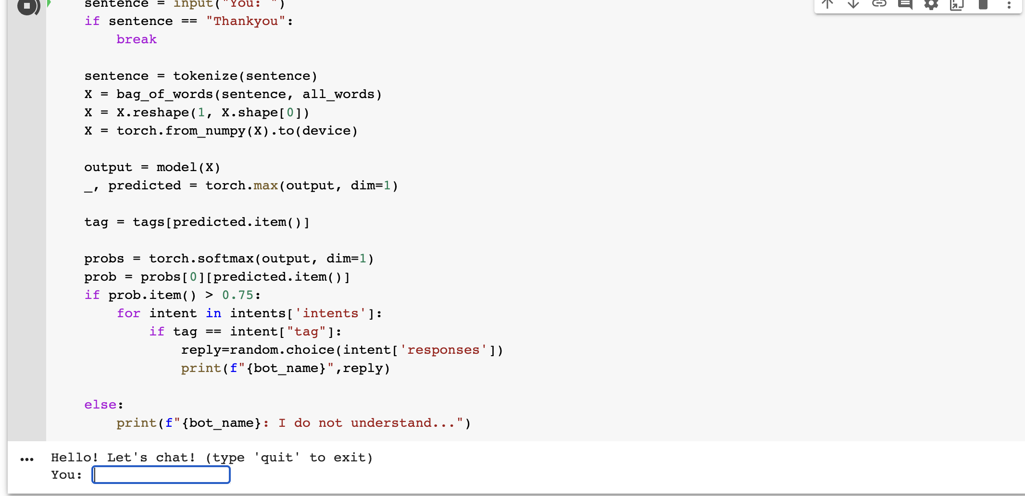
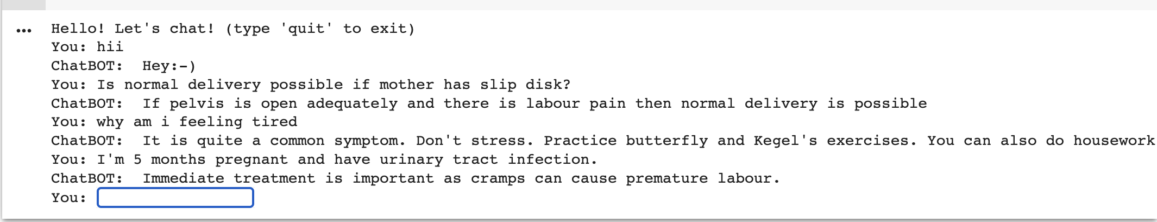
results

Slide 19
Conclusion:
Medical services are basic needs for human life although they normally have limited resources.
Modern technologies are utilized for increasing service capability and decreasing the operation cost.
Auto-response system or chatbot, which is widely known in the field of online businesses, can be applied to the medical services. The objective of this work is to implement the project (CHATBOT FOR PREGNANT WOMEN) service by using chatbot Technology.
Hence we are building a chatbot for pregnant women and their families to solve any of their queries in a humanoid way and consistently deliver accurate answers to its users.

Slide 20


